Slide 1


Safest Way to Travel
Air Travel or Ground which is the better option?
By Kevin Angotti

Slide 2

When looking at the number of fatalities from different travel methods for determining what is considered safe, I looked at the top 2 methods of travel. Traveling by vehicle and by air are the main methods most Americans choose, as well as those around the globe. Sense 1908, there have been a total of 105,479 fatalities caused by airline crashes, and if we just focus on years 2000 to 2009, there have only been 11,042 total fatalities. In contrast there were a total of 371,159 vehicle fatalities from 2000 to 2009.

Slide 3
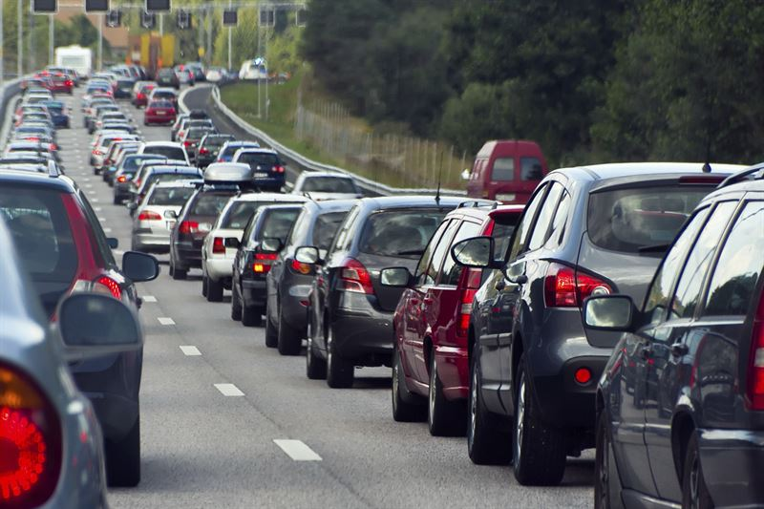
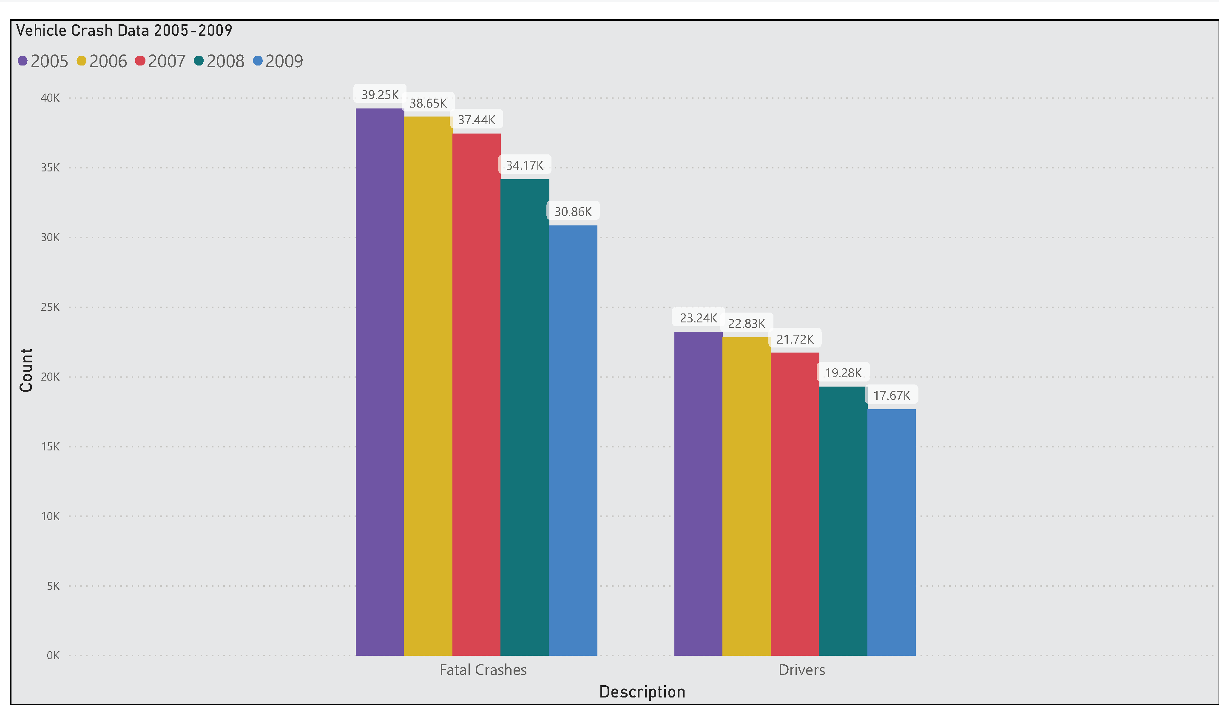
Taking a deeper look at a 10-year span of motor vehicle travel in the United States. Shown by the graphic to the right, you can see that there has been an average of 37 thousand fatalities each year by way of motor vehicle accidents. This does not consider injuries sustained in vehicle crashes but focuses strictly on accidents that resulted in fatalities. Looking at number of fatalities in different travel methods for determining what is considered safe, I looked at the top 2 methods of travel. Traveling by vehicle and by air are the main methods most Americans choose, as well as those around the globe. Sense 1908, there have been a total of 105,479 fatalities caused by airline crashes, and if we just focus on years 2000 to 2009, there have only been 11,042 total fatalities. In contrast there were a total of 371,159 vehicle fatalities from 2000 to 2009.

Slide 4
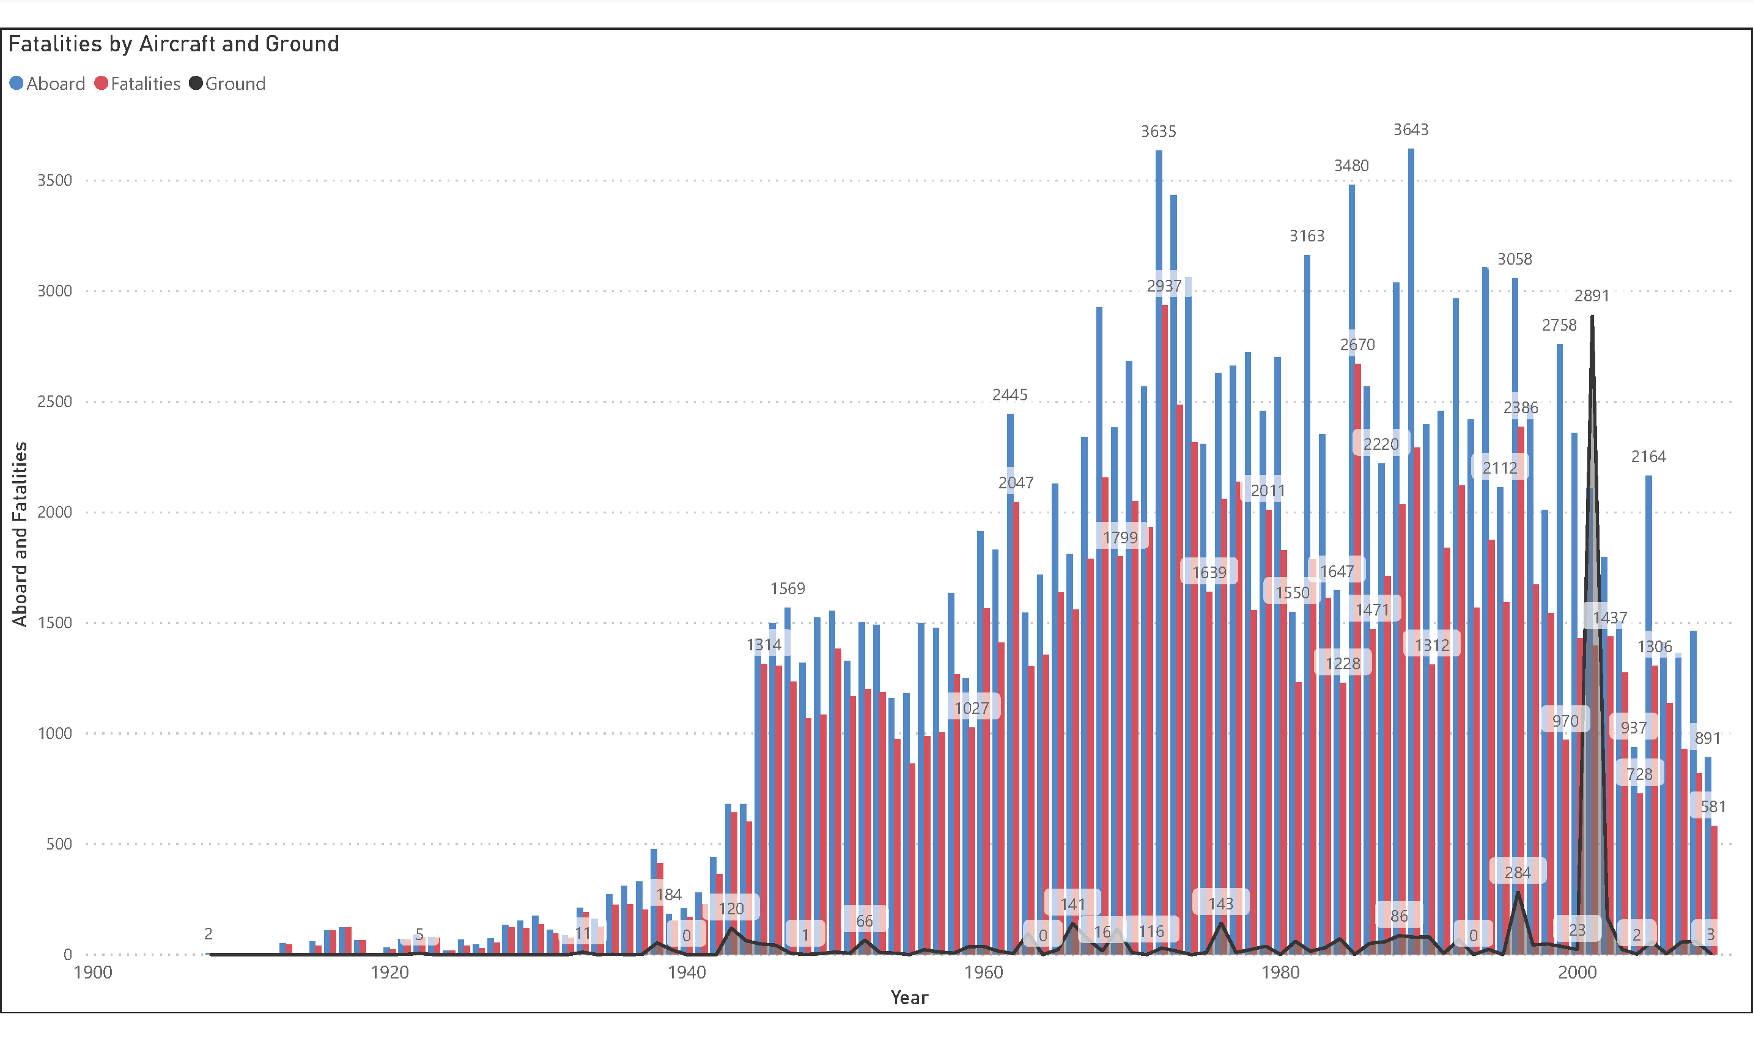

1908
Air travel has become a reliable method since the ’50s, and since 1908, it has averaged 1,044 fatalities each year.
2000–2009
In the ten years of 2000 to 2009, that average increased by less than 100 people, to an average of 1,104 per crash.

Slide 5
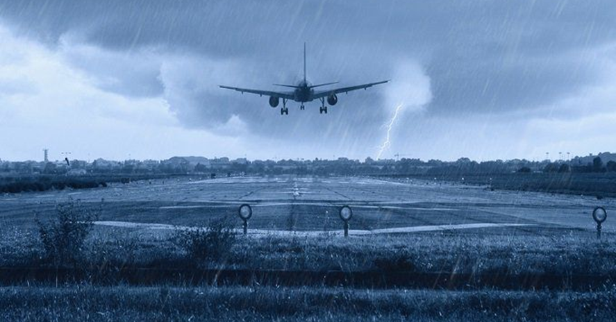
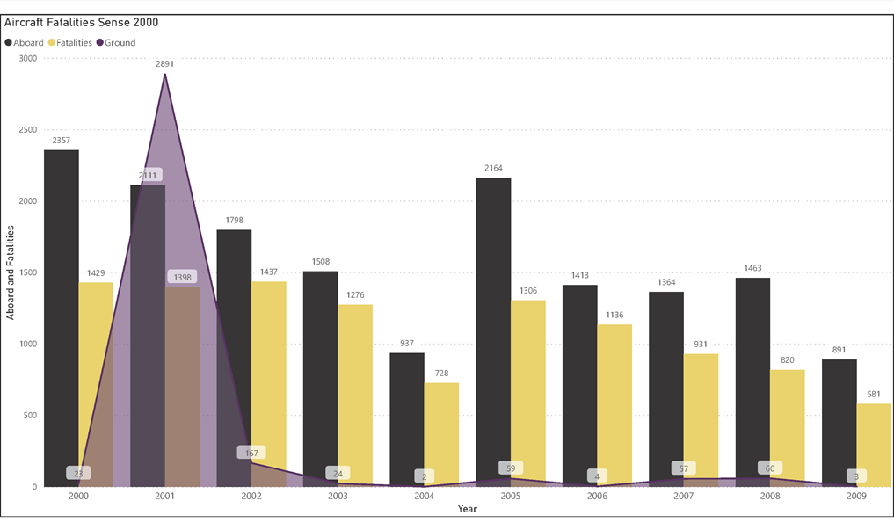
Typically airline crashes are contained to passengers aboard the aircraft, however there are other fatalities from a resulting crash. Since 1908, the number of fatalities not aboard a crashed aircraft has averaged around 56; however, in the 10-year span 2000 to 2009, that number increased to 329. This was mainly dune to September 11, 2001. If you remove that year, the average reduces to 44 fatalities.

Slide 6
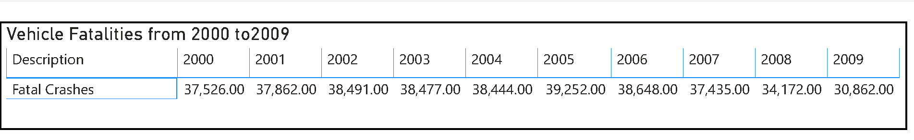
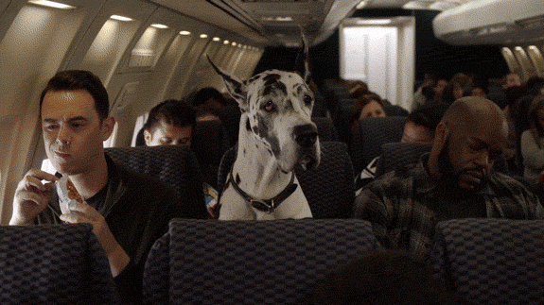
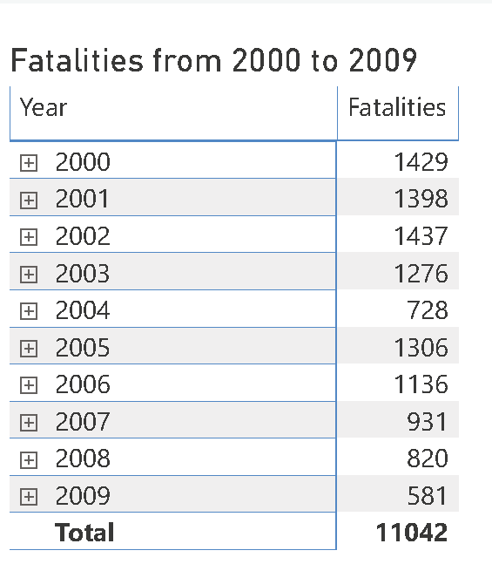
When you compare these two-travel methods side by side within the same period, the numbers are heavily in favor of air travel. If you take all the fatalities from air travel from 2000 to 2009 and compare that to just one year of passenger vehicle travel, you would be 3.5 times more likely to be in a fatal vehicle crash then one by air travel. In 2009 you would have had a less than .02% chance to be in a fatal airline crash. According to the National Safety Council, in 2018, your lifetime odds of being in a fatal motor vehicle crash were 1 in 106. They could not calculate the odds for air travel that year as there were too few to count. However, if you look at 2017’s odds, it was 1 in 11,175.

Slide 7

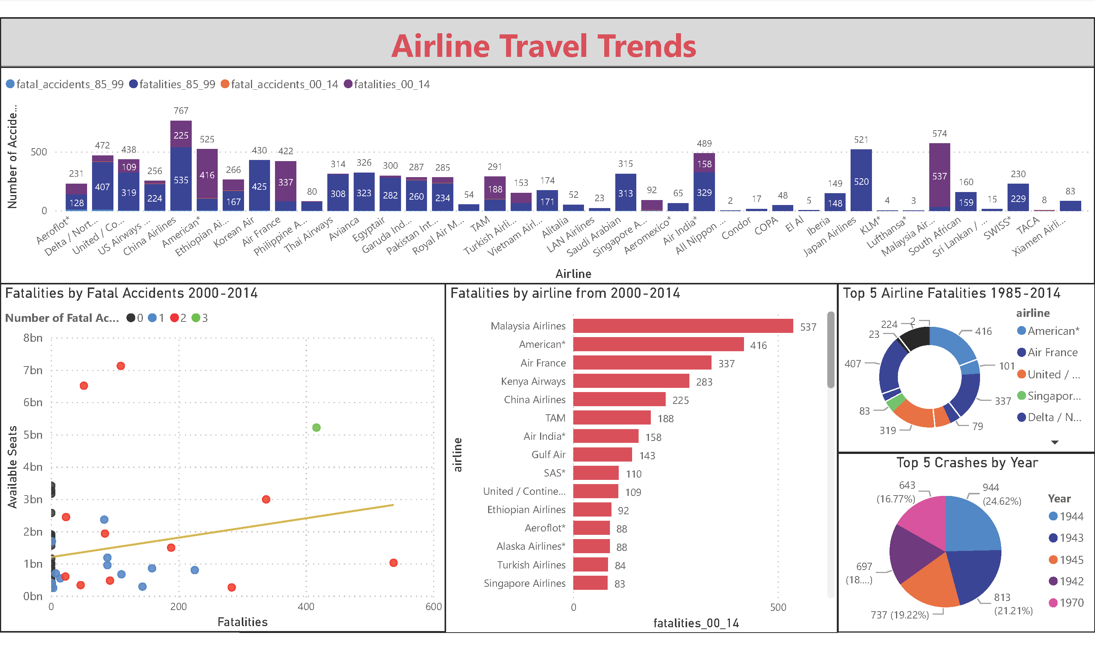
Here at Delta Airlines, we can be looked at as one of the safest options for air travel not only in the United States but the entire world. Delta Airlines has had 458 fatalities or 4% of total fatalities since 1929. Compared to American who has had 416 since 2000. However, for Delta, this statistic has improved tremendously. Since 2000, there have been 51 or .004% of the world's total fatalities during that time. Delta should be highlighting these statistics and known as the safest American based airliners.

Slide 8

Conclusion:
The main reason air travel gets such attention is that death tolls are higher for a single accident.
Vehicle crashes occur in much heavier dosage and the numbers are built up over time, the number of accidents can be misleading.
Other than the flights during September 11th, 2001, air travel has remained the safest option.
The thought of feeling safer in a vehicle stems from the operator having control over the transportation method.
In contrast to that of a commercial airliner, where the control lies in the hands of another person.

Slide 9
Questions?

Slide 10
Resources:
National Safety Council. Retrieved from https://injuryfacts.nsc.org/all-injuries/preventable-death-overview/odds-of-dying/
Ropeik, D. (2006). How Risky is Flying. NOVA. Retrieved from https://www.pbs.org/wgbh/nova/planecrash/risky.html#:~:text=The%20annual%20risk%20of%20being,is%20about%201%20in%205%2C000.

